Slide 1
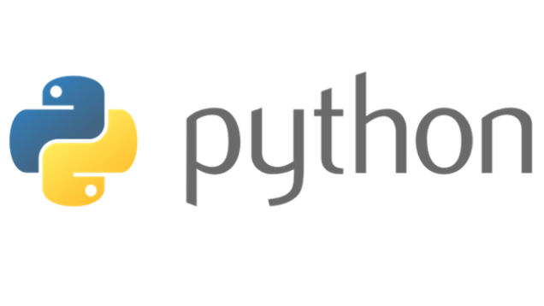
Course Id :INT 213

Slide 2
CA Component
1.Mini Project: Group size of 3, in case of odd number group size may be 2. compulsory 100 marks
Allocation week : 3 Submission week: 12, 13th and 14th week viva.
2. Practical Evaluation: student should code case study provided by teacher
Allocation week : 5 Submission week:5,
3. Code based Test: Student should answer the question based on code.
Allocation week : 9 Submission week: 10.

Slide 3
Syllabus and Books
..\Python Syllabus\syllabus.pdf

Slide 4

Programming ..??
Notes:
So ,Guys how many of you are afraid of programming ???? , who think that coding is the most difficult thing to do ??? Pick one of them and ask him/her the recipe of Maggi or tea …

Slide 5
Algorithms v/s programming
Algorithm: how to systematically perform a task
Write down as a sequence of steps
“Recipe”, or program
Programming language : describes the steps
What is a step? Degrees of detail
“Arrange the chairs” vs “Make 8 rows with 10
chairs in each row”

Slide 6
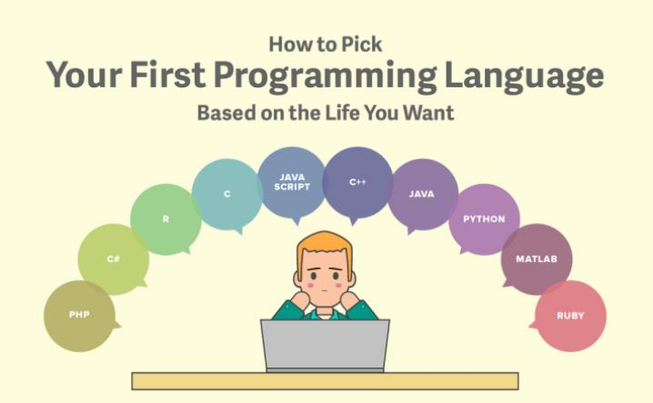
Which Programming Language ??

Slide 8
What is Python?
Python is an open source, object-oriented, high-level powerful programming language.
Developed by Guido van Rossum in the early 1990s. Named after Monty Python
Python runs on many Unix variants, on the Mac, and on Windows 2000 and later.

Slide 9


Slide 10
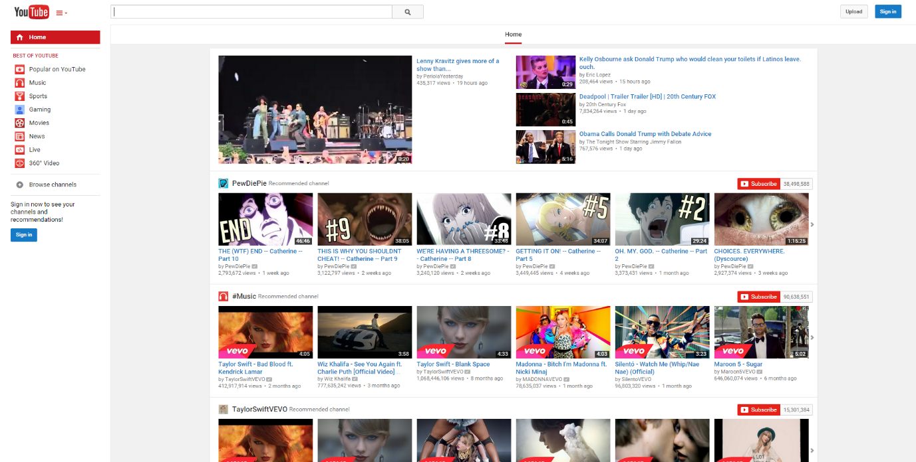
YOUTUBE
If you love watching hours of homemade and professional quality video clips on YouTube, you can thank Python for giving you that option. The foundation for Python helped YouTube integrate streaming videos into their pages, as well as the ability to like videos and embed certain information. YouTube is one of the most popular sites on the Internet, and it runs off of one of the most powerful languages in Python.
Notes:
We all know YouTube as the place to upload cat videos and fails. As one of the most popular websites in existence, it provides us with endless hours of video entertainment. The Python programming language powers it and the features we love.
If you love watching hours of homemade and professional quality video clips on YouTube, you can thank Python for giving you that option. The foundation for Python helped YouTube integrate streaming videos into their pages, as well as the ability to like videos and embed certain information. YouTube is one of the most popular sites on the Internet, and it runs off of one of the most powerful languages in Python.

Slide 11
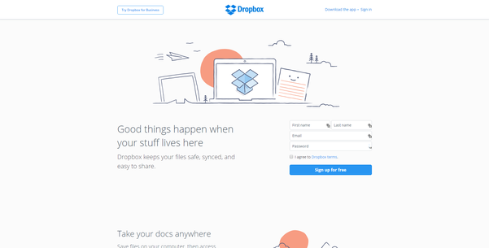
DROP BOX
What started as a powerful app, DropBox is now used by a variety of individuals, businesses, companies, organizations and more. This program lets you save files to a cloud-based service, that you can then access from anywhere in the world. With Python at the root of DropBox, there is no longer a need for USB sticks or blank CDs, since you can now save and share everything with your cloud-based account.
Notes:
DropBox started the online document storing revolution that has become part of daily life. We now store almost everything in the cloud. Dropbox allows us to store, sync, and share almost anything using the power of Python.
What started as a powerful app, DropBox is now used by a variety of individuals, businesses, companies, organizations and more. This program lets you save files to a cloud-based service, that you can then access from anywhere in the world. With Python at the root of DropBox, there is no longer a need for USB sticks or blank CDs, since you can now save and share everything with your cloud-based account.

Slide 12
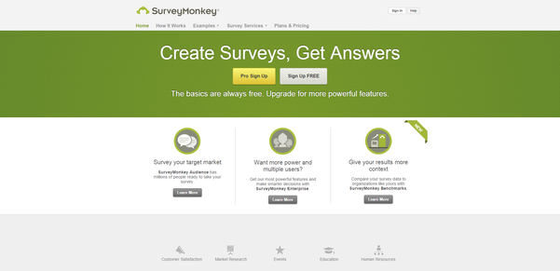
SURVEY MONKEY
Survey Monkey is the largest online survey company. They can handle over one million responses every day on their rewritten Python
Notes:
Survey Monkey is the largest online survey company. They can handle over one million responses every day on their rewritten Python.

Slide 13
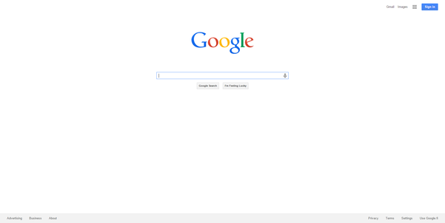
GOOGLE
It takes a lot of power to be able to handle the most popular search engine in the entire world. That is why Google uses Python for its mainframe foundation, as well as in addition to various apps that it runs in conjunction with the main site. The ease that Google provides for finding certain information, would be impossible without Python at the core.
Notes:
Python also provides the power behind the most popular search engine in the world – Google. The programming language can handle the traffic and computing needs of the search engine and its connected apps.
It takes a lot of power to be able to handle the most popular search engine in the entire world. That is why Google uses Python for its mainframe foundation, as well as in addition to various apps that it runs in conjunction with the main site. The ease that Google provides for finding certain information, would be impossible without Python at the core.

Slide 14
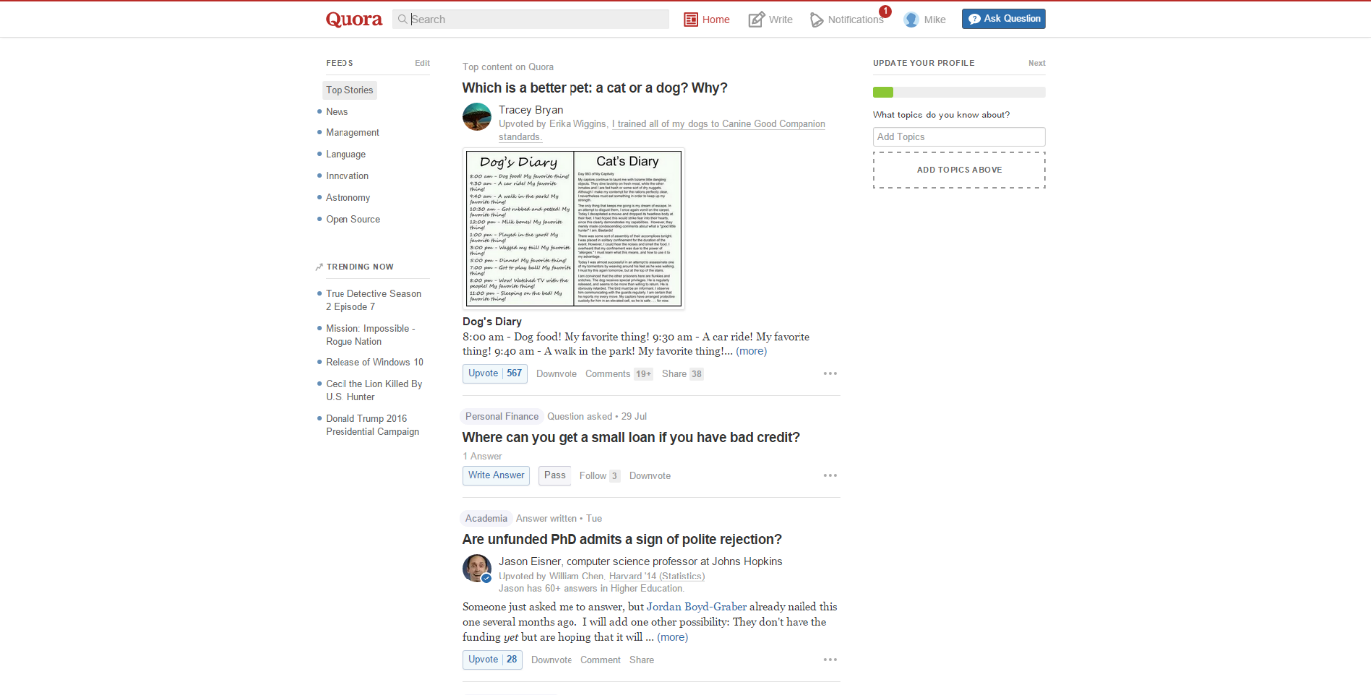
QUORA
Got a question? Ask it on Quora. This site compiles a list of questions and answers that come from a community of individuals. Those questions are then organized by various members of the community, which puts the most relevant information at the top. The creators of Quora, who happened to be former Facebook employees, decided to use Python to help them create the world’s best Magic 8 ball in Quora.
Notes:
Quora is the number one place online to ask a question and receive answers from a community of individuals. On their Python website relevant results are answered, edited, and organized by these community members.
Got a question? Ask it on Quora. This site compiles a list of questions and answers that come from a community of individuals. Those questions are then organized by various members of the community, which puts the most relevant information at the top. The creators of Quora, who happened to be former Facebook employees, decided to use Python to help them create the world’s best Magic 8 ball in Quora.

Slide 15
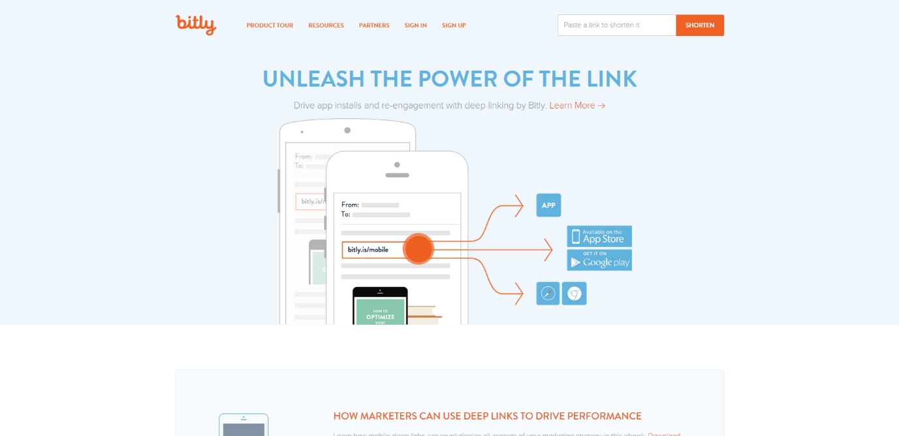
BITLY
A majority of the code for Bitly URL shortening services and analytics are all built
with Python. Their service can handle hundreds of millions of events per day.
Notes:
A majority of the code for Bitly URL shortening services and analytics are all built
with Python. Their service can handle hundreds of millions of events per day.

Slide 16
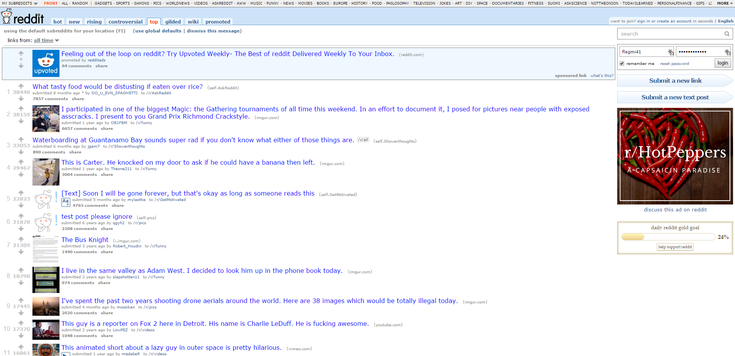
REDDIT
Reddit is one of the biggest open communities on the web. You have a question, want to talk about something in specific, or find tons of information regarding a particular topic, you can just look on Reddit. The site relies on Python to help them store user names, categorize subreddits, upload links to GIFs and, of course, award gold to valued posters.
Notes:
Reddit is known as the front page of the internet. It is the place online to find information or entertainment based on thousands of different categories. Posts and links are user generated and are promoted to the top through votes. Many of Reddit’s capabilities rely on Python for their functionality.
Reddit is one of the biggest open communities on the web. You have a question, want to talk about something in specific, or find tons of information regarding a particular topic, you can just look on Reddit. The site relies on Python to help them store user names, categorize subreddits, upload links to GIFs and, of course, award gold to valued posters.

Slide 17
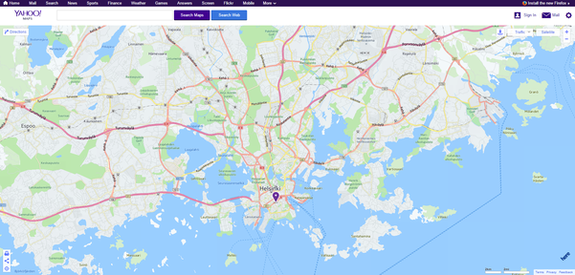
YAHOO MAPS
Yahoo maps may be losing the battle to other map service providers, but it still holds some powerful tools. Yahoo’s map program runs on Python as well as many of its other programs.
Much like Google, Yahoo also uses Python for a variety of different resources. Most valued may be Yahoo Maps. The API and programming behind the maps program, which is built with Python, allows for users to find locations, get directions and even find reviews about local places.
Notes:
Yahoo maps may be losing the battle to other map service providers, but it still holds some powerful tools. Yahoo’s map program runs on Python as well as many of its other programs.
Much like Google, Yahoo also uses Python for a variety of different resources. Most valued may be Yahoo Maps. The API and programming behind the maps program, which is built with Python, allows for users to find locations, get directions and even find reviews about local places.

Slide 18
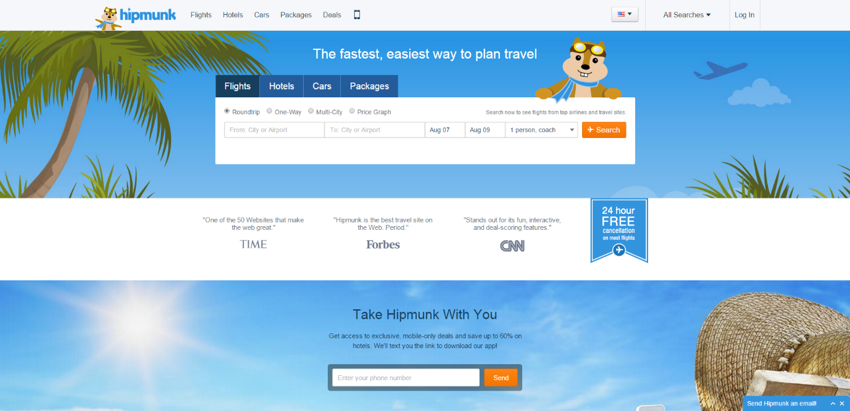
HIPMUNK
You can be placed in one of these companies ,if you are expert in python. You don’t need to approach them , then they will approach you.
If you love to travel, you have likely come across Hipmunk. And while the site lets you save money on booking your itinerary through Hipmunk, it is Python that keeps everything organized. Python also helps sort the best discounts and rates, so you can get the best packages available.
Notes:
So now lets start with Python …..For your better Future.
You can be placed in one of these companies ,if you are expert in python. You don’t need to approach them , then they will approach you.
If you love to travel, you have likely come across Hipmunk. And while the site lets you save money on booking your itinerary through Hipmunk, it is Python that keeps everything organized. Python also helps sort the best discounts and rates, so you can get the best packages available.

Slide 19
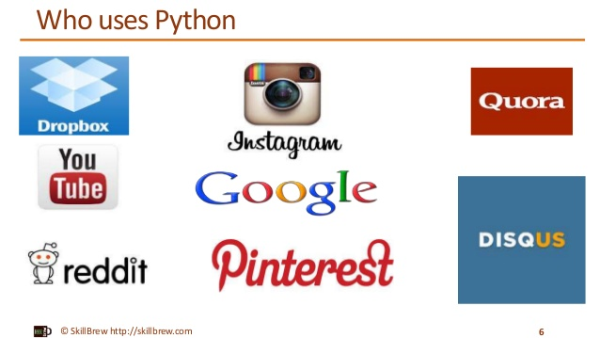
Your Future ….!!!

Slide 20
Let’s Find Out ….!!
Write a Program using any language you know to print “ HELLO WORLD “.

Slide 21
Python Is Easy to Use
C++ Program :
#include <iostream><br>
int main()
{
cout << "Hello World" << endl;
return 0;
}

Slide 22
C Program
#include <stdio.h>
int main(int argc, char ** argv)
{
printf(“Hello, World!\n”);
}

Slide 23
Java Program :
public class Hello
{
public static void main(String argv[])
{
System.out.println(“Hello, World!”);
}
}

Slide 24

Python Program :
print ( "Hello World")

Slide 25
COMPARISON WITH JAVA
Python programs are typically 3-5 times shorter than equivalent Java programs.
Python programs are generally expected to run slower than Java programs.
Java, on the other hand, can perform an efficient integer or floating point addition, but requires variable declarations for a and b.

Slide 26
COMPARISON WITH C++
Python code is often 5-10 times shorter than equivalent C++ code.
Python uses algorithmic approach unlike C++.
Python is an interpretable language whereas C++ is a compiled language.

Slide 27
SALIENT FEATURES
Simple- Python is a simple language. Reading a good Python program feels almost like reading English. It allows you to concentrate on the solution to the problem rather than the syntax i.e. the language itself.
Easy to Learn-Python is extremely easy to get started with. Python has an extraordinarily simple syntax.

Slide 28
Open source : Python is publicly available open source software, any one can use source code that doesn't cost anything.
Portable : High level languages are portable, which means they are able to run across all major hardware and software platforms with few or no change in source code. Python is portable and can be used on Linux, Windows, Macintosh, Solaris, FreeBSD, OS/2, Amiga, AROS, AS/400 and many more.
Object-Oriented : Python is a full-featured object-oriented programming language, with features such as classes, inheritance, objects, and overloading.

Slide 29
Python is Interactive : Python has an interactive console where you get a Python prompt (command line) and interact with the interpreter directly to write and test your programs. This is useful for mathematical programming.
Interpreted : Python programs are interpreted, takes source code as input, and then compiles (to portable byte-code) each statement and executes it immediately. No need to compiling or linking

Slide 30
Extendable : Python is often referred to as a “glue” language, meaning that it is capable to work in mixed-language environment. The Python interpreter is easily extended and can add a new built-in function or modules written in C/C++/Java code.
Libraries : Databases, web services, networking, numerical packages, graphical user interfaces, 3D graphics, others.
Supports :Support from online Python community

Slide 31
VERSIONS OF PYTHON
Python 1.0 - January 1994
Python 1.5 - December 31, 1997
Python 1.6 - September 5, 2000
Python 2.0 - October 16, 2000
Python 2.1 - April 17, 2001
Python 2.2 - December 21, 2001
Python 2.3 - July 29, 2003
Python 2.4 - November 30, 2004
Python 2.5 - September 19, 2006
Python 2.6 - October 1, 2008
Python 2.7 - July 3, 2010

Slide 32
VERSIONS OF PYTHON
Python 3.0 - December 3, 2008
Python 3.1 - June 27, 2009
Python 3.2 - February 20, 2011
Python 3.3 - September 29, 2012
Python 3.4 - March 16, 2014
Python 3.5 - September 13, 2015

Slide 33
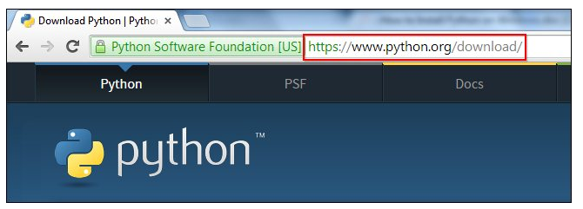
DOWNLOADING PYTHON

Slide 34
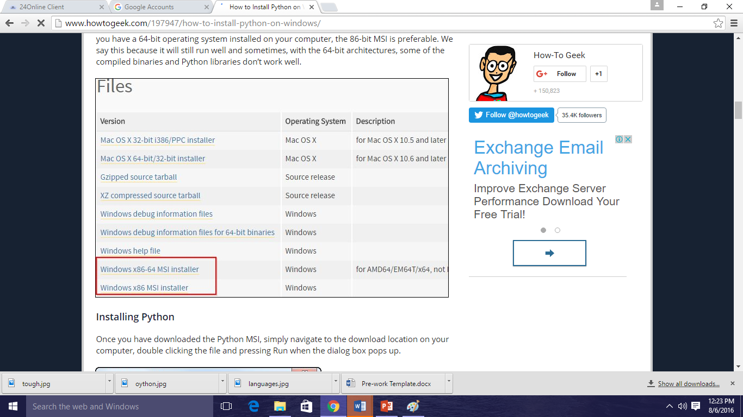
VERSION

Slide 35
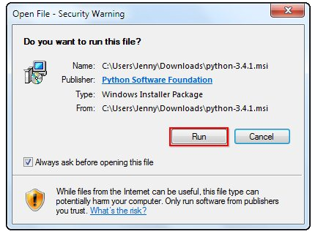

Slide 36
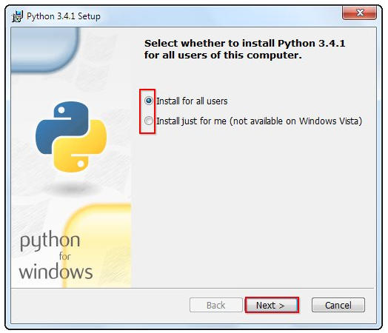

Slide 37
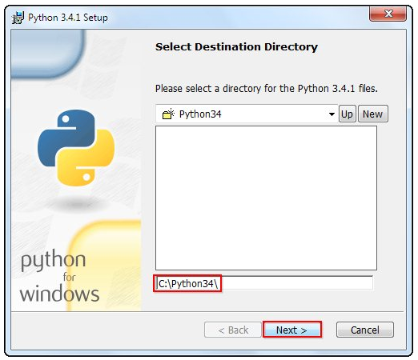

Slide 38
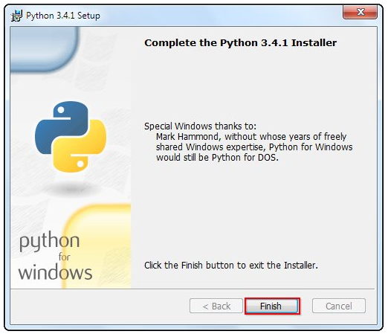

Slide 39
Questions ??

